Slide 1
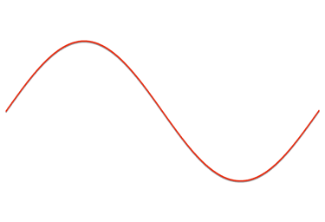
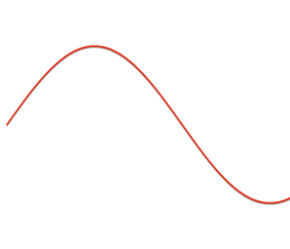
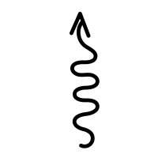
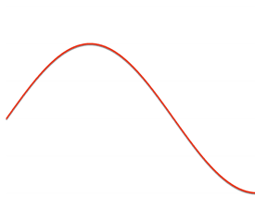
Coherent
b_{k}
Decoherent
0
1
(a)
(d)
Non-Ideal Recipient b_{NI}
r₁
r₁
(b)
peak
(e)
Bond Strength b_{KF}
peak
min
min
(c)
x_{c1a1}= 1.0
(f)
x_{c1a1}= 0.5
c₁
a₁
c₁
c₁
a₁
c₂
Phonon Transfer b_{PH}
-
-
+
+
+
+

